Slide 1
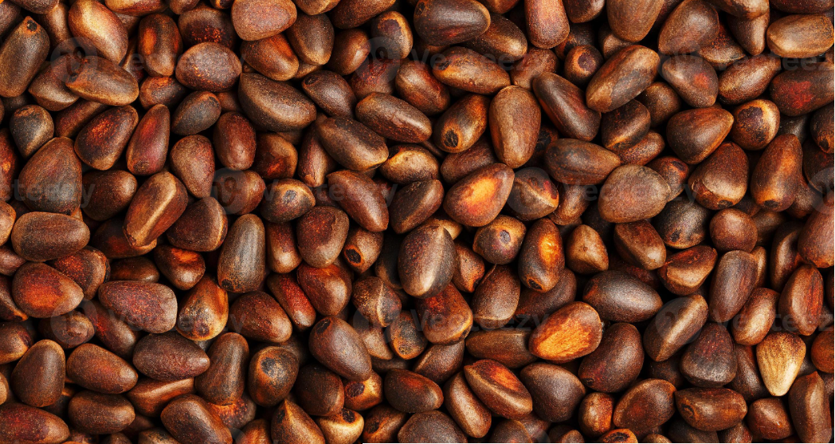
THE POTENTIAL OF PALM KERNEL SHELL AS A SUSTAINABLE BIOFUEL AND ALTERNATIVE TO CHARCOAL
By Mahay Incorporated

Slide 2
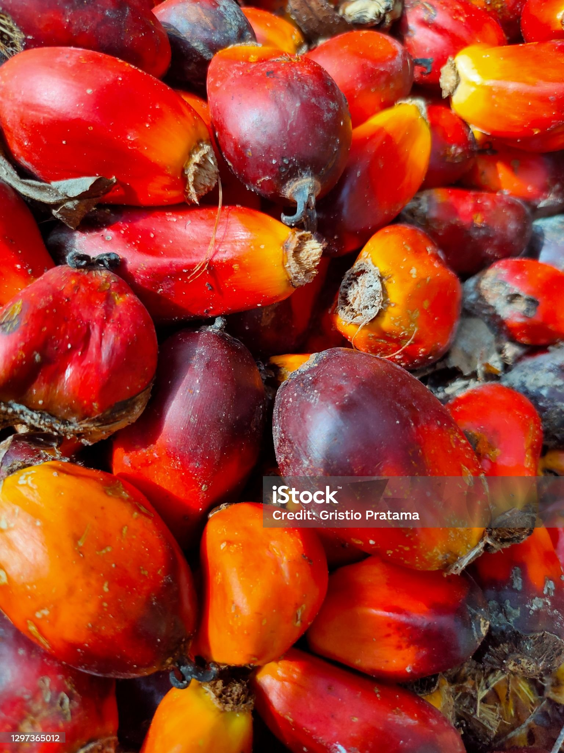

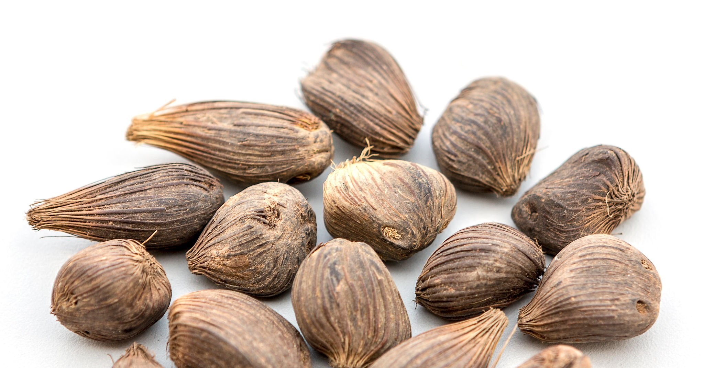
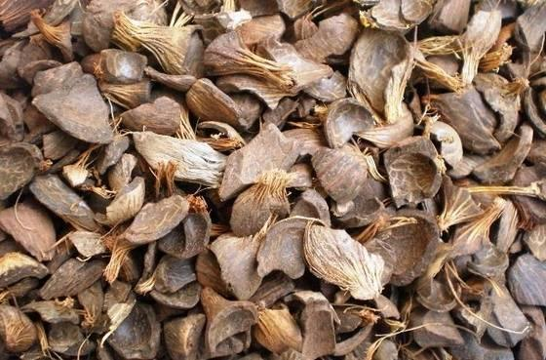
Agenda
Background Information
Our Objectives
Origin and Availability
Socio-economic Benefits
Conclusion

Slide 3
Introduction
In this presentation, we explore the feasibility of Palm Kernel Shell (PKS) as a sustainable biofuel and substitute for conventional charcoal. There is an urgent need for renewable and environmentally acceptable energy sources due to the rise in global energy consumption as well as the negative environmental effects of fossil fuels and conventional biomass like charcoal. PKS is a byproduct of producing palm oil, and because of its abundance, minimal environmental impact, and energy efficiency, it offers a promising alternative. The physical and chemical characteristics of PKS, as well as its potential for energy production, advantages for the environment, economic feasibility, and difficulties in applying it, are all assessed in this presentation.

Slide 4
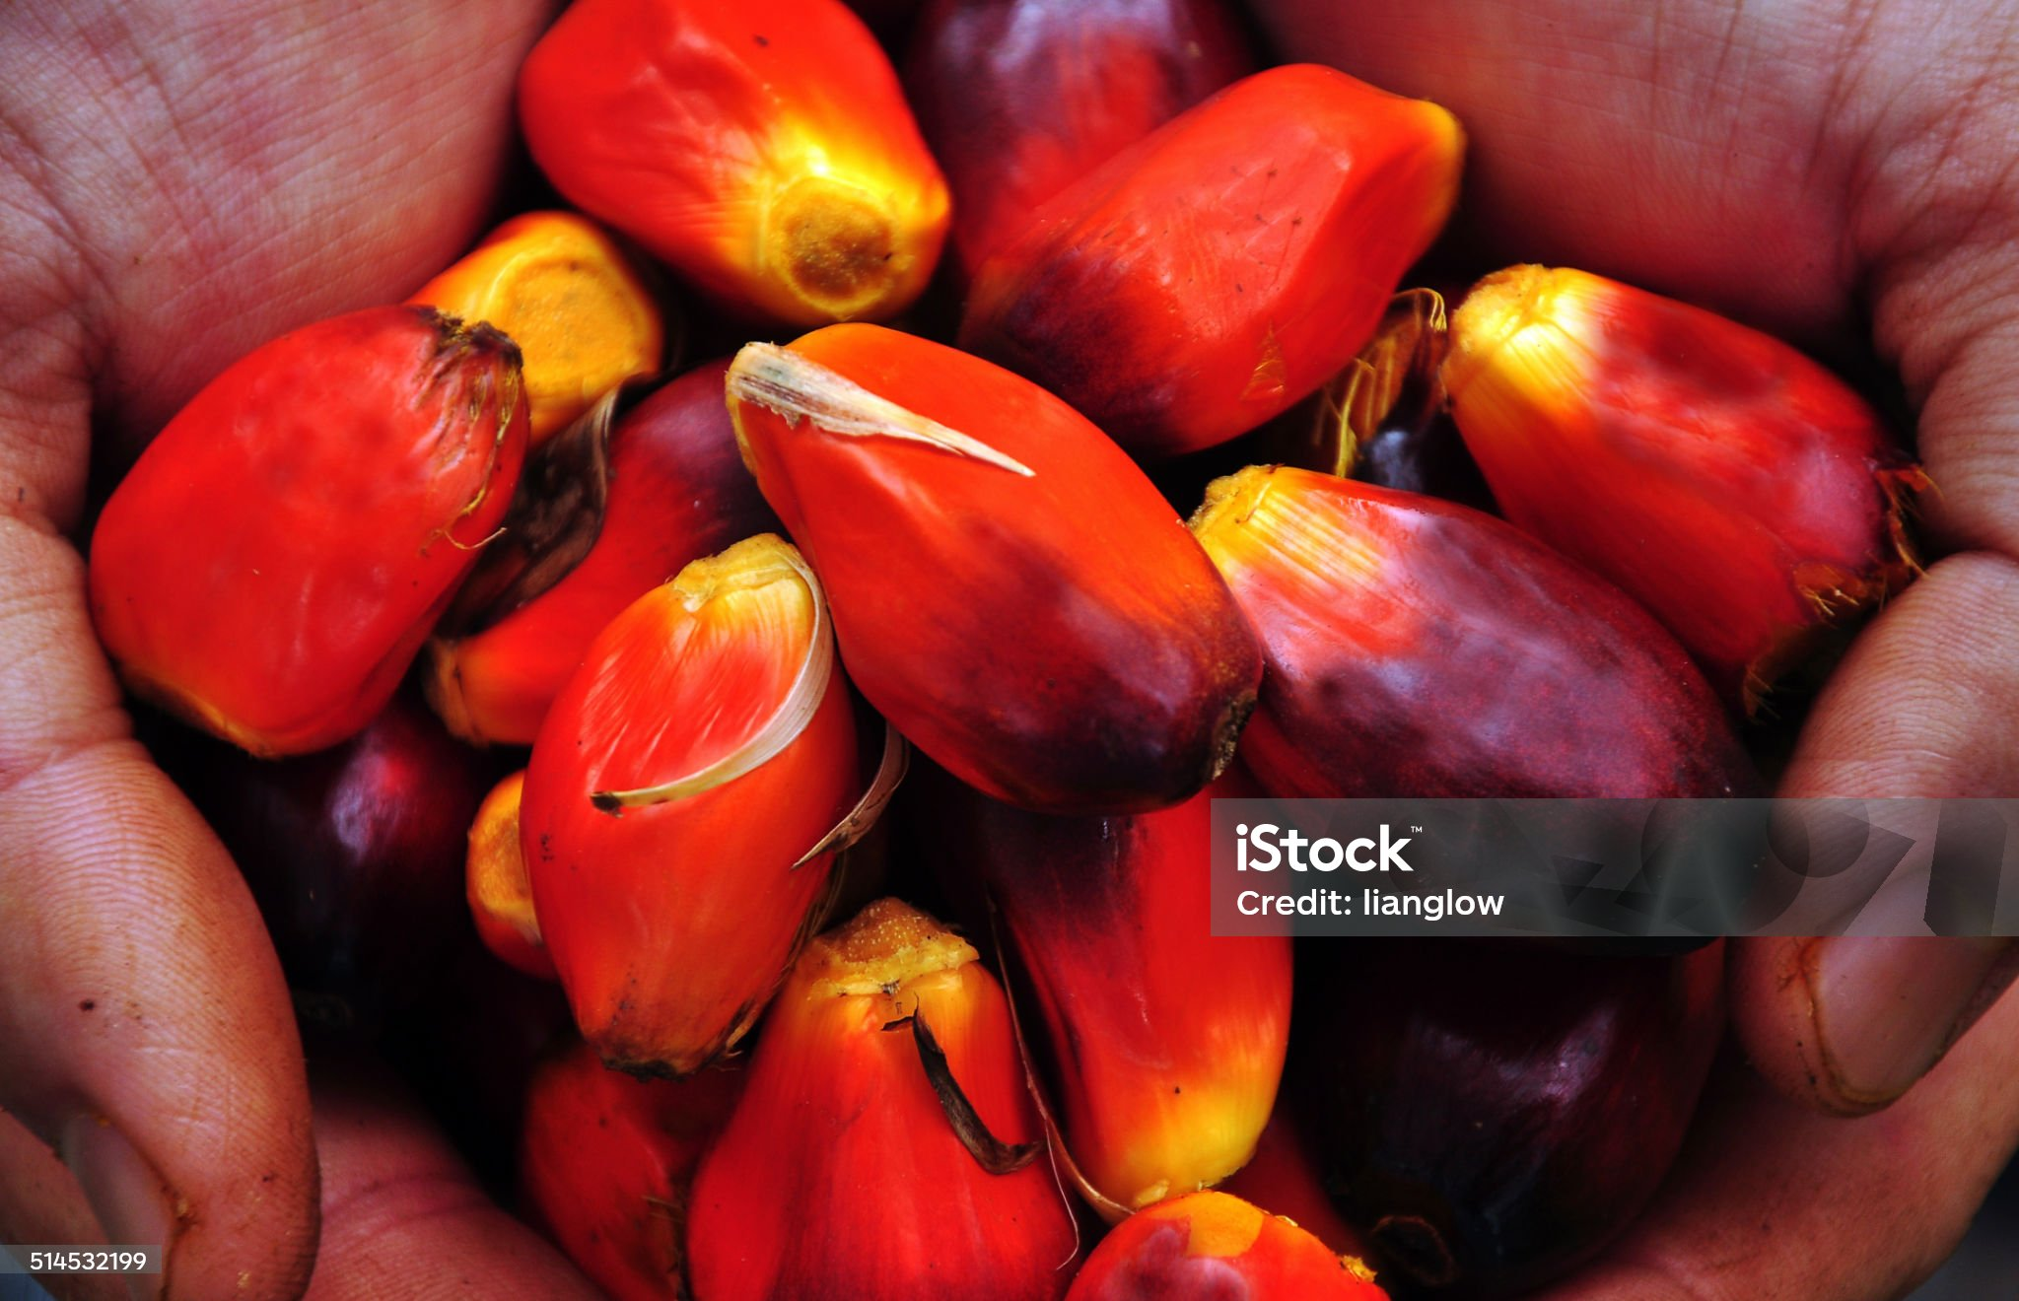
GLOBAL ENERGY CHALLENGES
Background information
The rising global energy demand, driven by population growth and economic development, is depleting finite fossil fuel resources and exacerbating environmental issues such as greenhouse gas emissions and climate change. These challenges highlight the urgent need for sustainable energy solutions like renewable energy sources, which offer a viable alternative to mitigate environmental impacts and ensure long-term energy security.

Slide 5
THE ROLE OF BIOMASS IN ENERGY PRODUCTION
Background information
Biomass energy, derived from sources like wood, agricultural residues, and waste, has historically been used for heating, cooking, and as a fuel source. It offers benefits such as being renewable, carbon-neutral, and helping to manage waste. However, biomass also has limitations, including lower energy conversion efficiency compared to fossil fuels, potential competition for land with food production, and the release of particulate matter and other pollutants when burned. Despite these challenges, biomass remains a viable alternative to fossil fuels, contributing to a more sustainable energy future when managed properly.

Slide 6
IMPORTANCE OF FINDING ALTERNATIVES TO TRADITIONAL CHARCOAL
Background information
Charcoal production contributes to environmental degradation through deforestation and air pollution. Deforestation occurs as trees are cut down to make charcoal, leading to habitat loss, biodiversity depletion, and soil erosion. Additionally, the burning of wood to produce charcoal releases pollutants such as carbon monoxide, particulate matter, and volatile organic compounds, contributing to air pollution and adverse health effects. To address these issues, cleaner and more sustainable alternatives like palm kernel shells (PKS) can be utilized, which reduce the environmental impact associated with charcoal production.

Slide 7
Analyzing the Energy Potential of Palm Kernel Shells
Palm kernel shells (PKS) have a relatively high calorific value compared to other biomass sources, making them an efficient energy source. The calorific value of PKS typically ranges from 4,000 to 4,500 kcal/kg, which is comparable to or even higher than other biomass fuels such as wood chips or agricultural residues. In terms of energy output, PKS can be utilized in various applications, including power generation, industrial processes, and residential heating. When used as a fuel for power generation in biomass power plants, PKS can provide a significant amount of electricity due to its high energy content. Overall, while PKS may not match the calorific value of some conventional fuels, its high energy content, coupled with its renewable and sustainable nature, makes it a valuable alternative for meeting energy needs while reducing environmental impacts.

Slide 8
Comparing the environmental impact of PKS and charcoal:
Comparing PKS and charcoal production in terms of emissions, carbon footprint, and environmental impacts reveals significant differences:
1 - Emissions: Charcoal production emits substantial amounts of carbon dioxide (CO2) due to deforestation and the burning of wood. Additionally, the incomplete combustion of wood releases pollutants like carbon monoxide (CO) and volatile organic compounds (VOCs), contributing to air pollution. In contrast, PKS production emits fewer CO2 emissions as it utilizes waste material rather than cutting down trees.
2 - Carbon Footprint: Charcoal production has a higher carbon footprint compared to PKS due to deforestation and associated land-use changes. PKS, being a byproduct of palm oil production, has a lower carbon footprint as it utilizes waste material that would otherwise be disposed of or left to decay, emitting methane (a potent greenhouse gas) in the process.

Slide 9
Comparing the environmental impact of PKS and charcoal:
Comparing PKS and charcoal production in terms of emissions, carbon footprint, and environmental impacts reveals significant differences:
3 - Environmental Impacts: Charcoal production contributes to deforestation, habitat loss, and soil erosion, leading to biodiversity depletion and ecosystem degradation. Additionally, the burning of wood for charcoal production releases pollutants and contributes to climate change. On the other hand, PKS production does not require additional land use or deforestation, thus mitigating these environmental impacts.
Overall, PKS present a more environmentally sustainable option compared to charcoal production, with lower emissions, a reduced carbon footprint, and fewer adverse environmental impacts.

Slide 10
Assessing the economic viability of PKS as a biofuel:
The cost of PKS production can vary depending on factors such as local labour costs, transportation expenses, and processing methods. However, PKS is generally considered a cost-effective energy source due to its abundance and availability as a byproduct of palm oil production. Compared to other biomass sources, PKS often has lower production costs because it does not require dedicated cultivation or additional resources.
In palm oil-producing regions, PKS holds significant market potential due to its abundance and the established infrastructure for palm oil production. As a byproduct of palm oil extraction, PKS is readily available in large quantities, making it an attractive option for various applications such as power generation, industrial processes, and residential heating.

Slide 11
Assessing the economic viability of PKS as a biofuel:
The economic benefits of PKS extend beyond its direct use as a fuel. For palm oil producers, utilizing PKS as an energy source can provide additional revenue streams and reduce waste disposal costs. Furthermore, the substitution of PKS for fossil fuels can help reduce dependency on imported energy sources, thereby enhancing energy security and reducing foreign exchange expenditures.
Overall, PKS presents promising economic opportunities in palm oil-producing regions, offering cost-effective energy solutions, additional revenue streams, and contributing to local economic development. As renewable energy policies and sustainability initiatives gain traction globally, the market potential for PKS is expected to further expand.

Slide 12
Identifying challenges and proposing solutions for the widespread adoption of PKS:
The adoption of PKS as a fuel source may face certain barriers:
Technical: Adapting barbecue equipment for PKS combustion may pose challenges due to its different properties compared to traditional fuels like charcoal or propane. Solutions could involve researching and developing barbecue designs optimized for PKS combustion or retrofitting existing equipment to accommodate PKS.
Logistical: Transporting and storing PKS could be cumbersome due to its bulkiness and moisture content, potentially impacting supply chain efficiency. Investing in specialized storage and handling facilities, as well as exploring palletisation or densification methods to reduce volume, can address these logistical challenges.

Slide 13
The adoption of PKS as a fuel source may face certain barriers:
Regulatory: Regulatory hurdles such as unclear policies or restrictions on biomass fuel usage may hinder the adoption of PKS in barbecue businesses. Engaging with regulatory authorities to advocate for supportive policies and ensuring compliance with existing regulations through collaboration and communication are essential steps to overcome these barriers.
Practical solutions for a barbecue business to overcome these challenges include investing in equipment adaptations or developments, optimizing logistics processes, and engaging with regulatory bodies to create a conducive environment for PKS adoption. Collaboration with suppliers, regulators, and industry peers can facilitate the successful integration of PKS into barbecue operations.

Slide 14
Overview of the Palm Oil Industry and Production Processes
The palm oil industry is a major global sector that produces palm oil, a versatile and widely used vegetable oil. Palm oil is derived from the fruit of the oil palm tree (Elaeis guineensis), primarily grown in tropical regions, with Indonesia and Malaysia being the largest producers, accounting for over 85% of global production.
Cultivation:
Oil palm trees are cultivated on large plantations, typically in tropical climates.
Trees begin to bear fruit within 3-4 years of planting and have a productive lifespan of around 25 years.

Slide 15
Harvesting:
Fresh fruit bunches (FFBs) are harvested by hand or with mechanical tools.
Each bunch can weigh between 10-25 kg and contains numerous individual fruits.
Processing:
Threshing: FFBs are transported to mills where they are threshed to separate the fruit from the bunch.
Sterilization: The fruit is sterilized using steam to prevent fermentation and facilitate oil extraction.
Pressing: The sterilized fruit is pressed to extract crude palm oil (CPO) from the mesocarp and palm kernel oil (PKO) from the kernel.

Slide 16
Clarification and Purification:
CPO is clarified to remove impurities, then purified and refined to meet food-grade standards.
PKO undergoes a similar process of extraction, clarification, and purification.

Slide 17
PKS as a byproduct and its global availability
Palm kernel shells (PKS), a byproduct of the palm oil industry, are abundantly produced in palm oil-rich regions like Southeast Asia, particularly Indonesia and Malaysia. With their high calorific value, PKS presents a promising alternative to fossil fuels and conventional biomass for energy production. Utilizing PKS can help reduce greenhouse gas emissions, manage agricultural waste effectively, and promote sustainability within the palm oil industry. Additionally, the economic benefits for palm oil producers include generating additional revenue and reducing waste disposal costs, while enhancing local energy security by reducing reliance on imported fuels.

Slide 18
Socio-economic Benefits of PKS for Small Businesses:
The adoption of PKS as a fuel source can create numerous employment opportunities in palm oil-producing regions. These opportunities span across various stages of the supply chain, including:
Collection and Processing: Gathering and preparing PKS for use requires labour, creating jobs in rural and agricultural communities.
Transportation and Logistics: Moving PKS from production sites to end-users involves transportation services, logistics management, and related support roles.
Equipment Manufacturing and Maintenance: Designing, manufacturing, and maintaining specialized equipment for burning PKS can foster local industries and technical services.
Economic Benefits include costs savings, local sourcing and revenue diversification.

Slide 19
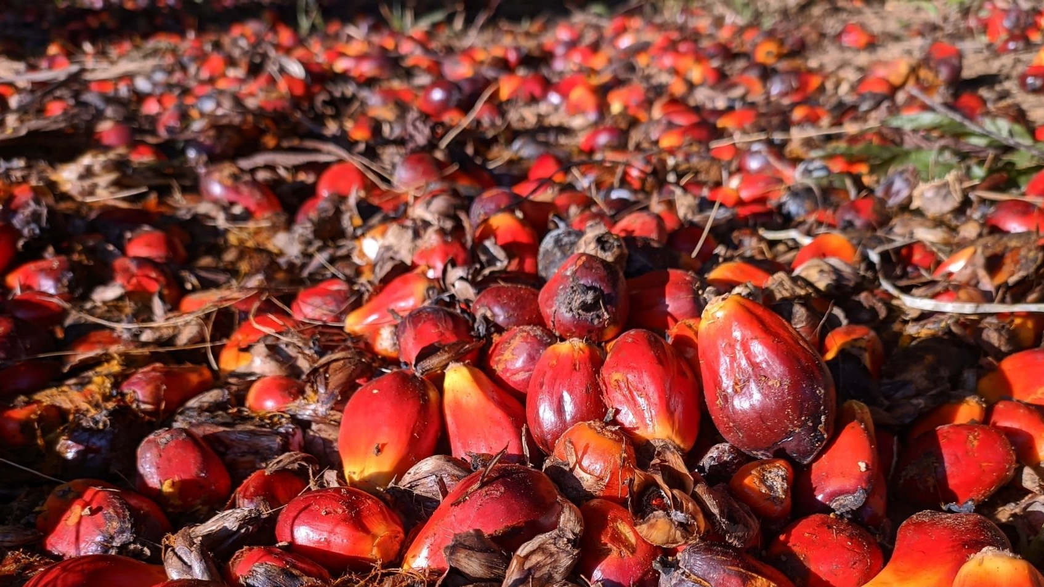

Conclusion
Palm Kernel Shell has significant potential as a biofuel and an alternative to charcoal, offering environmental and economic benefits. Addressing technical, logistical, and regulatory challenges is crucial for realizing this potential. This presentation provides a comprehensive analysis of PKS, highlighting its viability and proposing solutions for its adoption as a sustainable energy source.

Slide 20
Thank you
Mahay Incorporated
25th, May 2024.

